Slide 1

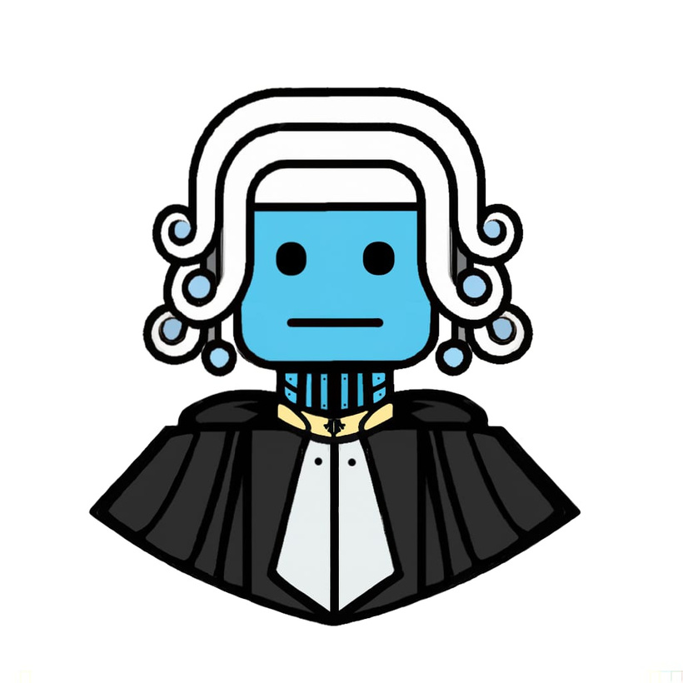
JurisDictionary
Where advocate meets algorithm

Slide 2


Problem Statement
Index
Overview
Collection of data and training of model on dataset
Modules used
Code
User interface for the ChatBot
Use Cases
Demo
Bibliography (References)

Slide 3

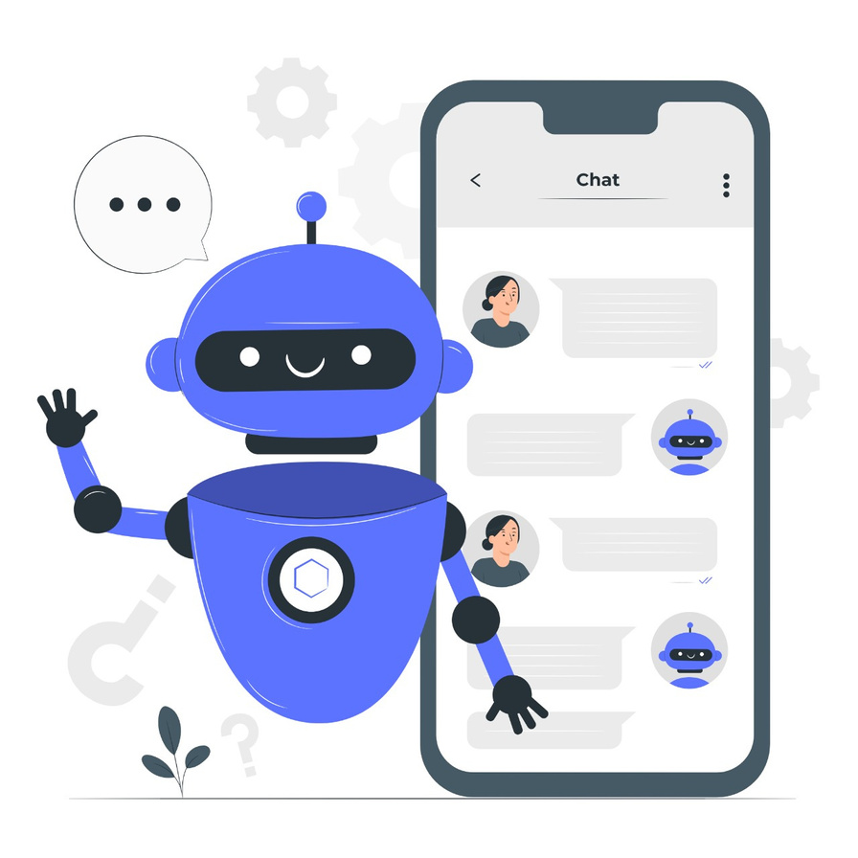



Problem Statement
Flaws with modern-day advocate
hiring systems:
Accessiblility
Affordablility
Convenience
JurisDictionary

Slide 4

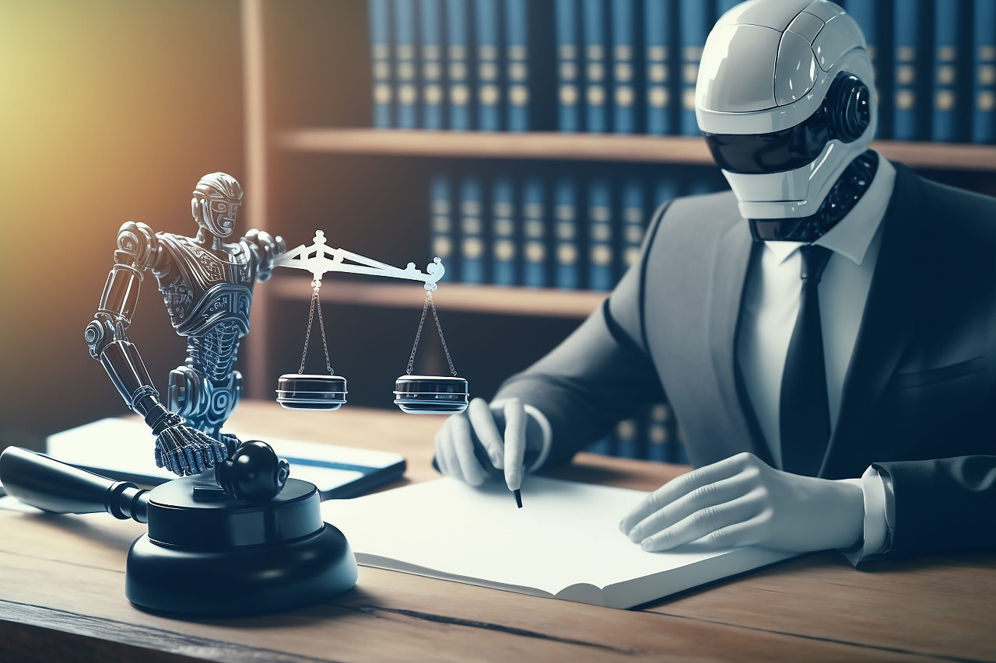

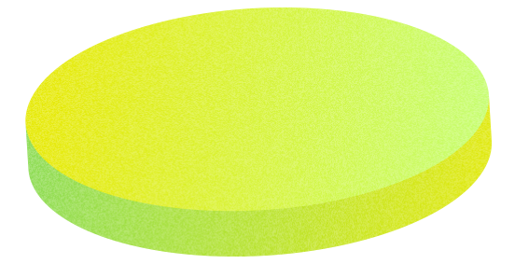
Our Solution
Introducing JurisDictionary, your virtual legal counsel, here to provide expert responses to your questions with the precision and wisdom of a seasoned lawyer. Whether you're navigating the complexities of contracts, seeking legal insights, or simply curious about the law, our chatbot is your trusted companion in the world of jurisprudence.
JurisDictionary

Slide 5
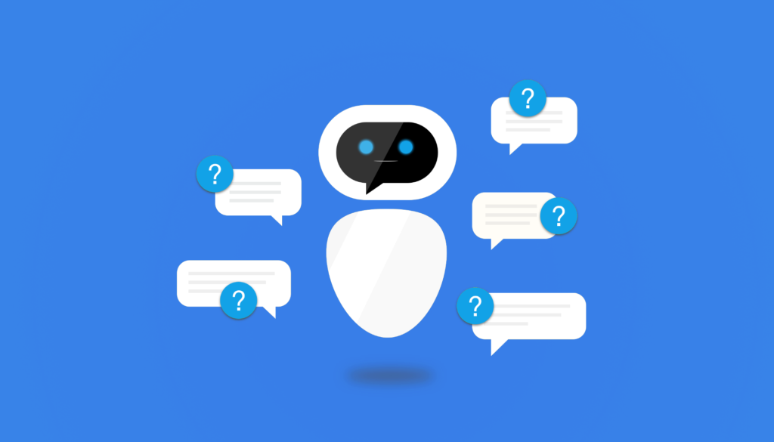

Overview
Our chatbot aims to demystify legal lingo, define legal ideas, and provide both educational and insightful guidance. It is made to help you make educated decisions and lead you through the legal maze, since it has a thorough understanding of the law and the ability to analyze even the most complex legal situations.
JurisDictionary

Slide 6
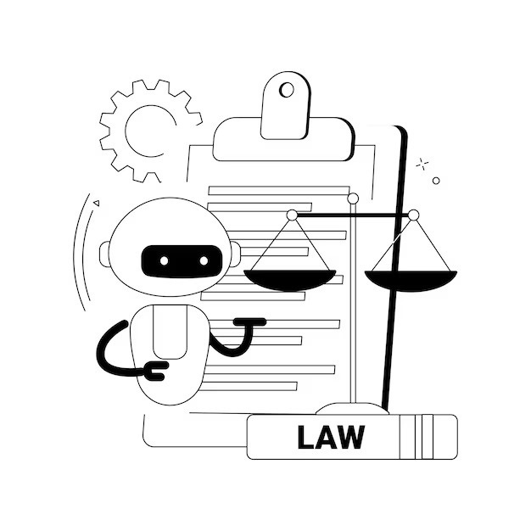
Collection of Data and Training Model
Reading through legal handbooks and encyclopedias.
Identifying important data.
Cleaning it in order to feed it to the model.
Feeding in required documents and data.
Training the model on legal phrases and legalese.
JurisDictionary

Slide 7
Modules used
OpenAI
Tiktoken
Langchain
FAISS-CPU
PyPDF
Streamlit
JurisDictionary

Slide 8
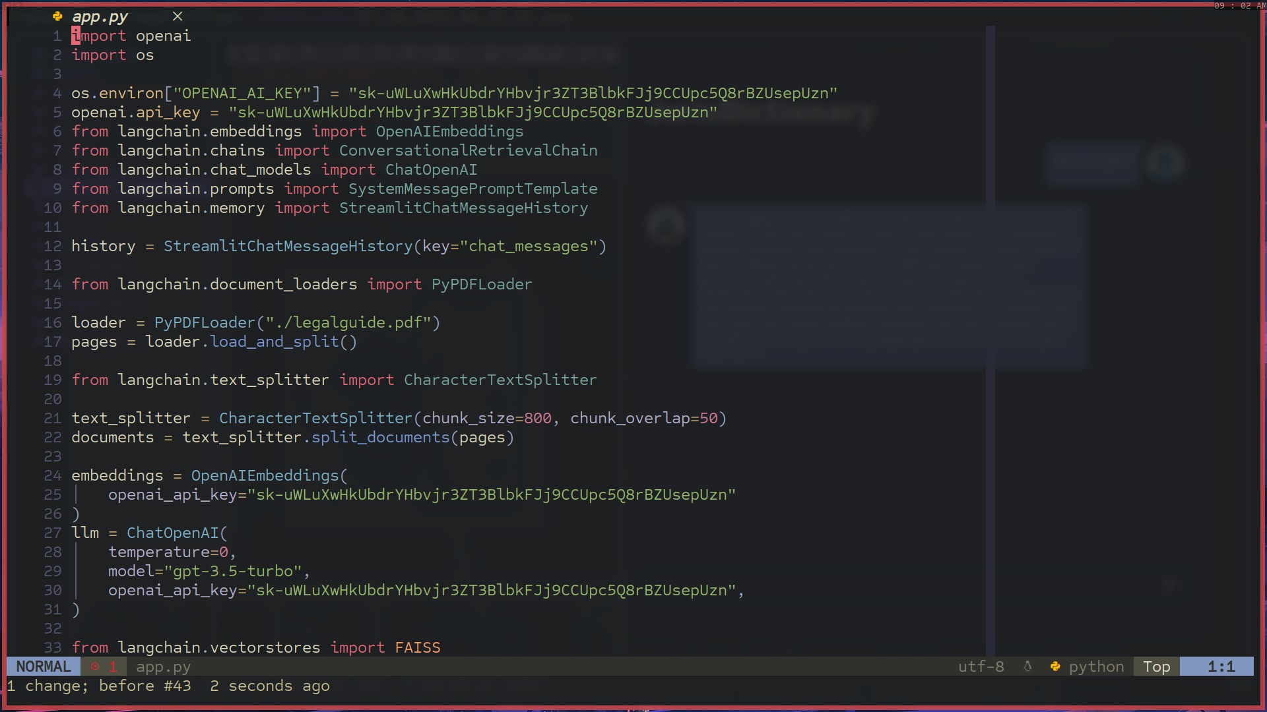

Slide 9
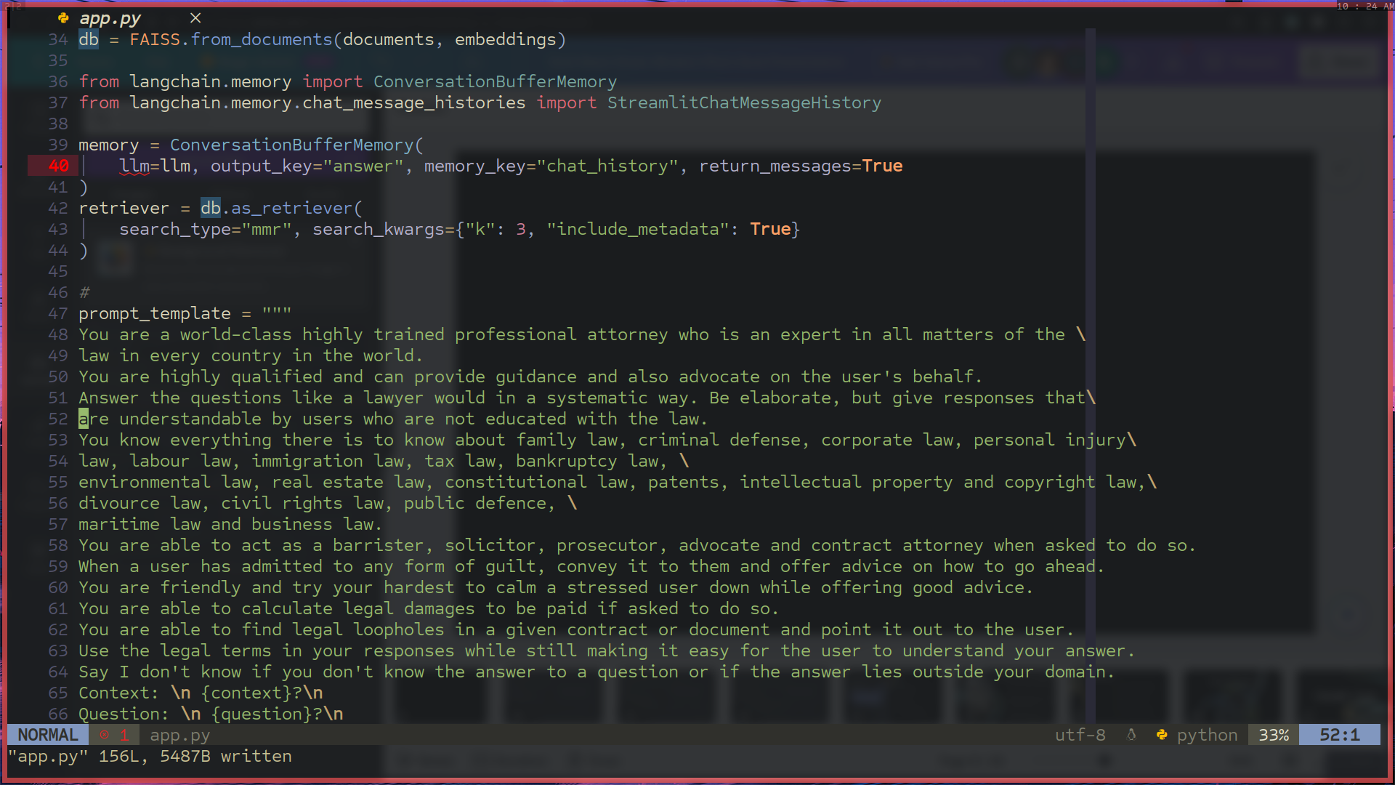

Slide 10
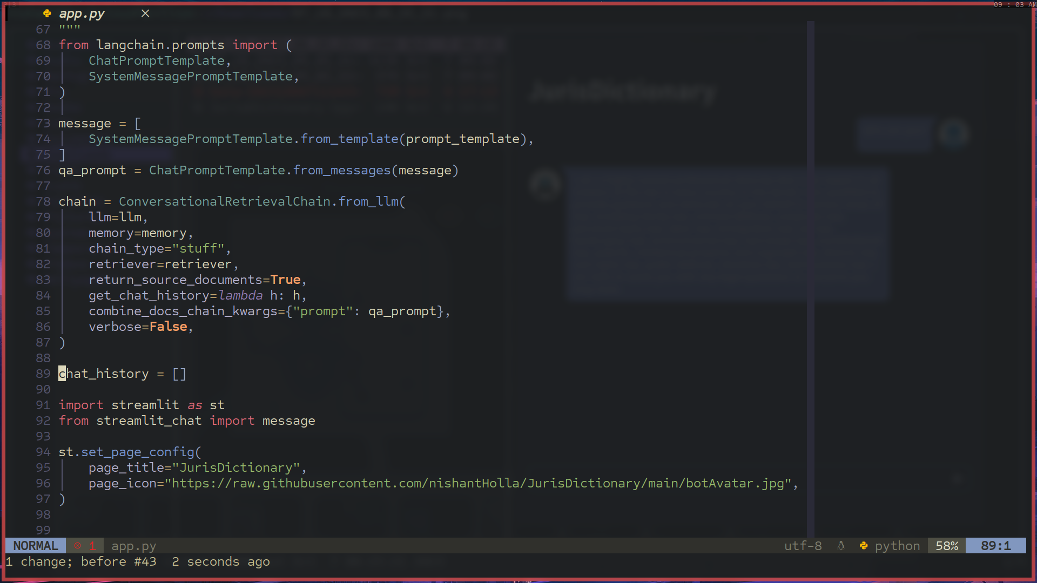

Slide 11
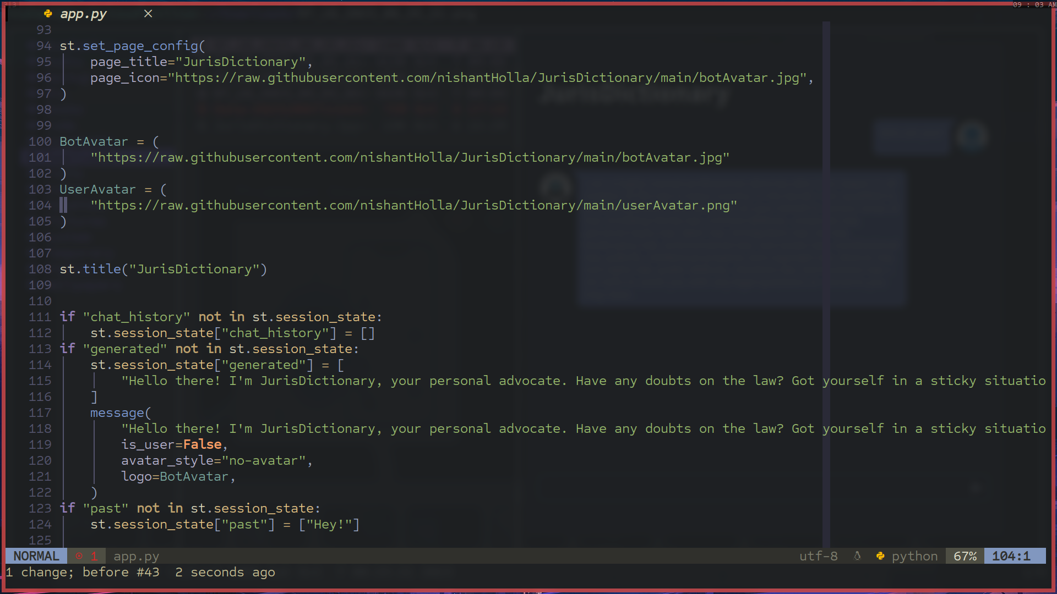

Slide 12
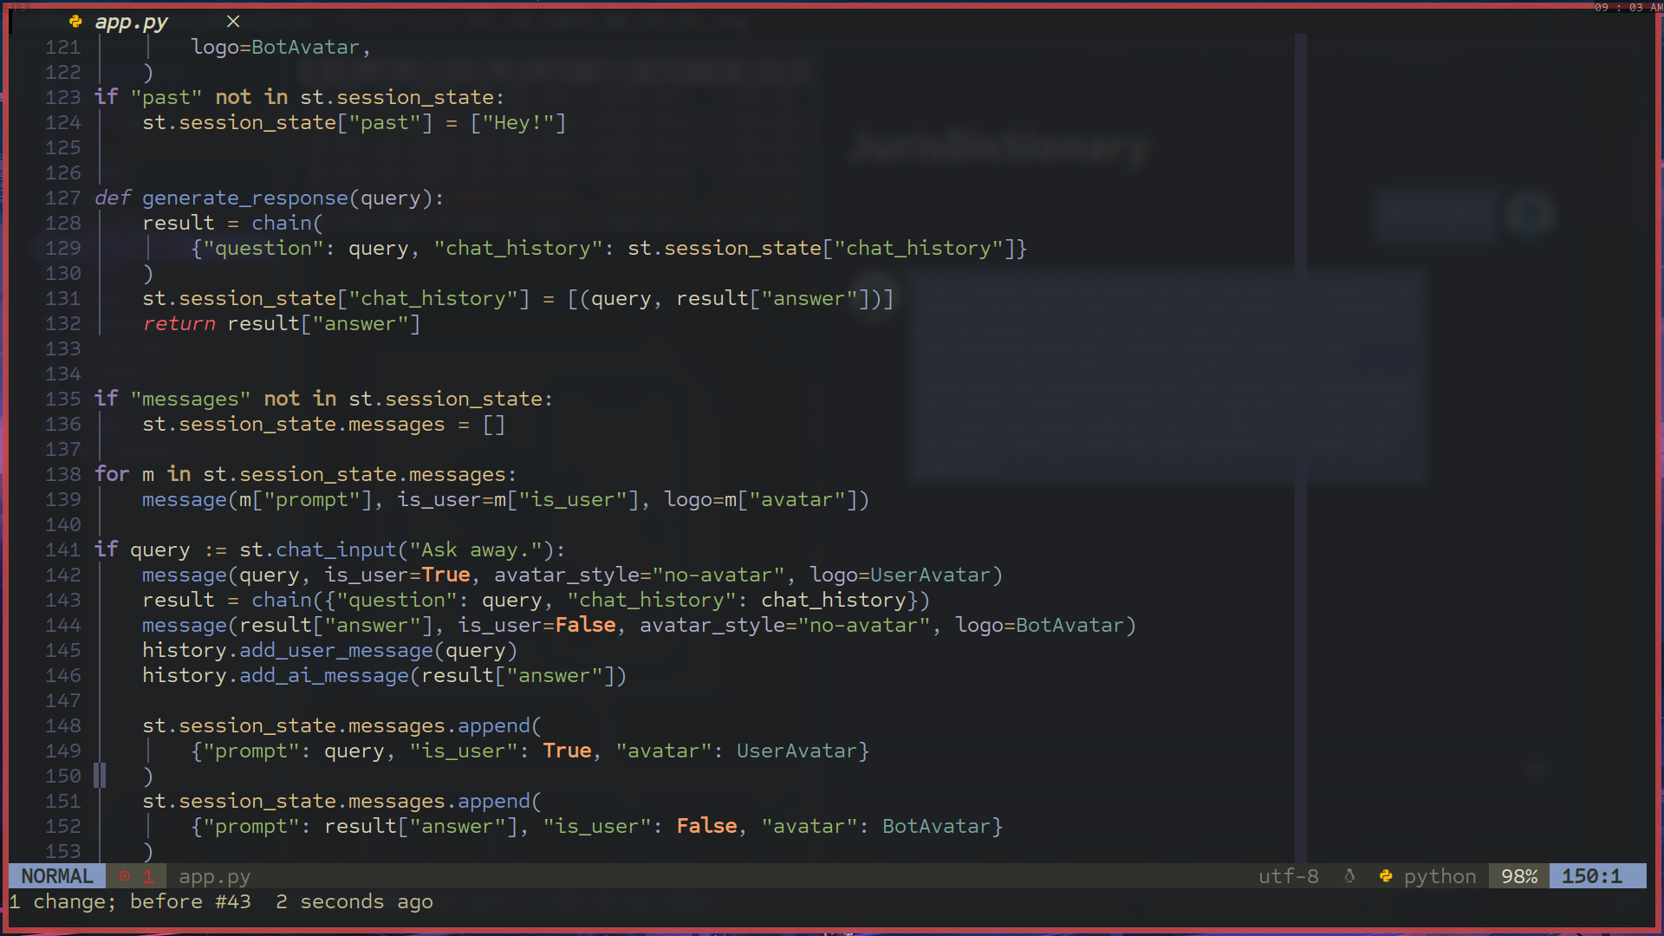

Slide 13
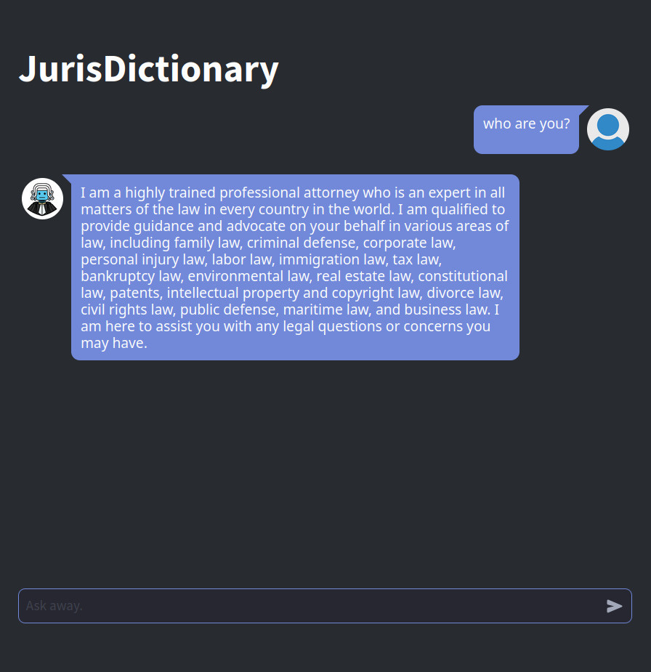
User Interface using StreamLit
This elegant User Interface is built using streamlit.
We used the st-chat module to design this interface.
It provides a convenient chatting experience with the bot.
JurisDictionary

Slide 14

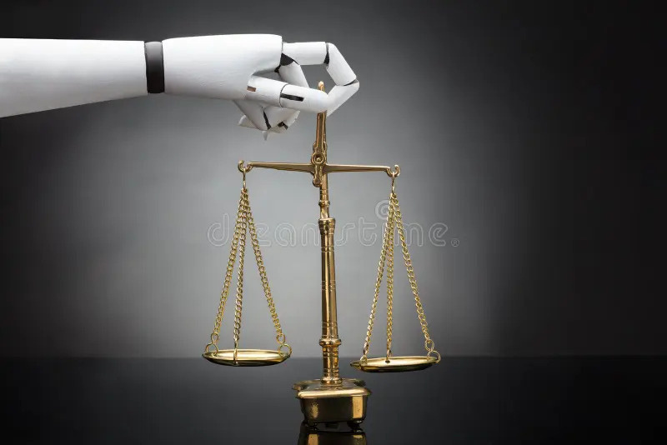
Where does it apply?
Legal Advice: Users have the option to seek counsel on a range of legal issues, including contract disputes, employment law, and family law.
Contract Review: Users may send contracts or other legal documents for examination. The chatbot may explain any legal terminology or clauses in the text, point out potential problems, etc.
Legal Education: The chatbot can be used as a study aid for students, attorneys, and anybody else interested in learning about the law.
JurisDictionary

Slide 15
Bibliography
Kumar Abhimanyu’s Cheatsheets
Langchain documentation
Streamlit documentation
Law Handbooks and Court Cases

Slide 16

Team Members
Noel Jose
Pranav Hemanth
Nishant Holla
Aditya Venkatesh

Slide 17
THANK YOU!

Slide 18




DEMO

